Slide 1


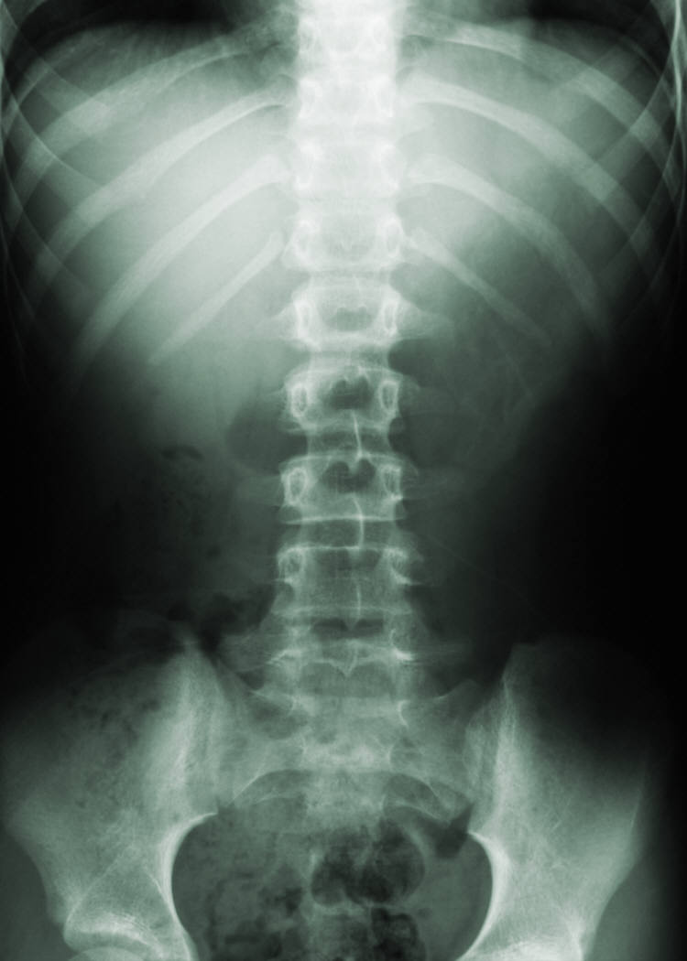
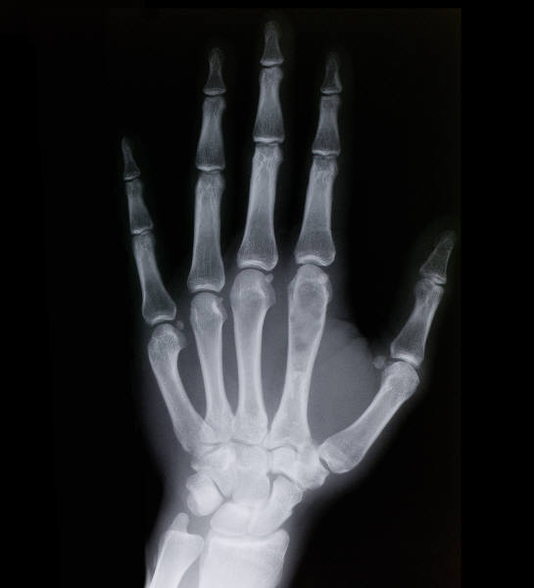
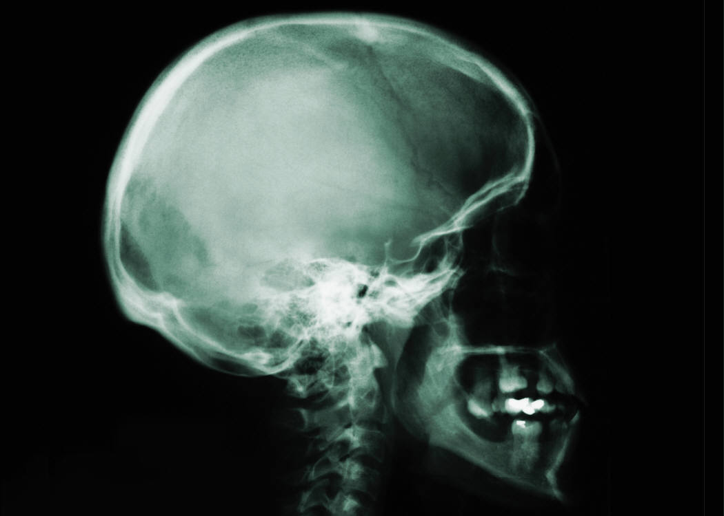
Sliding Block Systems
Oscillatory Solutions to Systems of a Block Sliding Along a Freely Rotating Beam
setup
Abstract
Lagrangian mechanics
Type the abstract here. To remove bullet points, just click the Bullets button on the Home tab.
List methods and descriptions here
Method 1
Method 2
Method 3
List objectives here
Objective 1
Objective 2
Objective 3
procedure
 | Heading | Heading | Heading
Item | 122 | 233 | 345
Item | 759 | 856 | 290
Item | 228 | 134 | 238
Item | 954 | 875 | 976
Item | 324 | 325 | 301
Item | 199 | 137 | 186
Add title if necessary. Click the B button on the home tab to add bold formatting.
Background item
Background item
Background item
Phase space
List objectives here
Objective 1
Objective 2
Objective 3
Type a caption for the data content or pictures here.
conclusion
acknowledgements
Result 1
Result 2
Result 3
Conclusion 1
Conclusion 2
Conclusion 3

